Slide 1
Data Analysis in Sociology
Saint-Petersburg 2025
Seminar 2
Ilya lyapin
BI Developer at Avito

Slide 2

Quote of the day
Saint-Petersburg 2025

Slide 3

Plan for today
Saint-Petersburg 2025
Correlation (Pearson, Kendall, Spearman)
Paired and independent t-tests, chi-sq, non-parametric test
ANOVA
Practice

Slide 4
Correlation
Saint-Petersburg 2025
What types of correlation exist, difference between them and implementation in R

Slide 5
Correlation
Saint-Petersburg 2025
Correlation - a statistical measure that measures the extent to which these two measures are associated with each other
Usually when we talk about correlation we distinguish between 2 types of correlation coefficients:
Pearson
Spearman

Slide 6
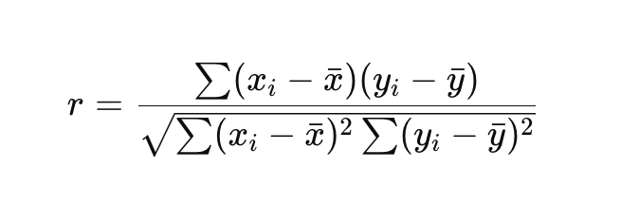
Correlation
Saint-Petersburg 2025
Pearson’s correlation coefficient is a coefficient that measures the linear relationship between two variables
It is a parametric measure which means that it has some assumptions about the distribution of data:
Linearity
Normality
Homogeneity of variances
Continuous data

Slide 7
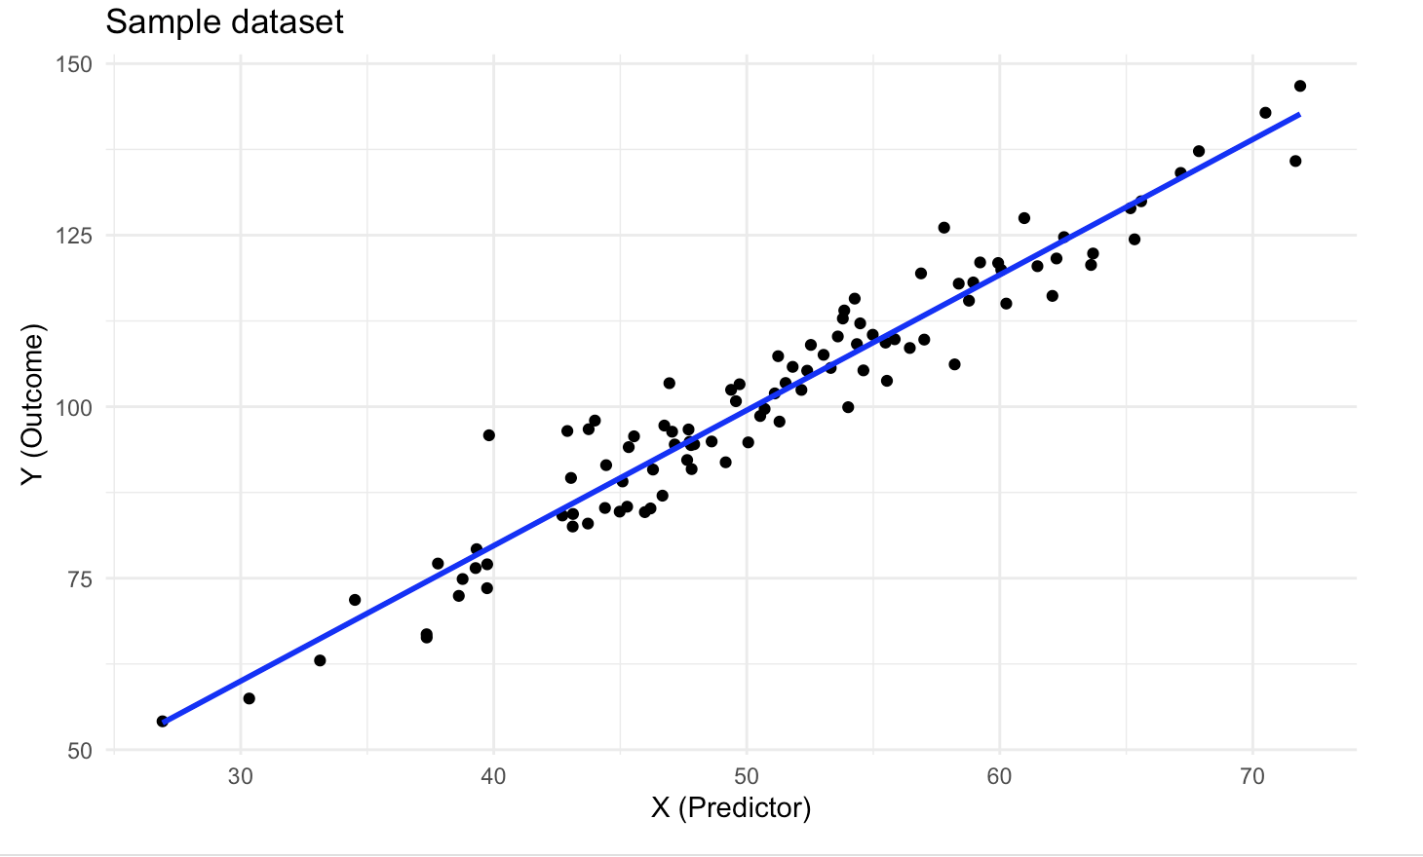
Correlation
Saint-Petersburg 2025
Linearity assumption can be checked with a simple scatterplot

Slide 8
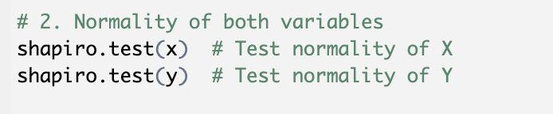
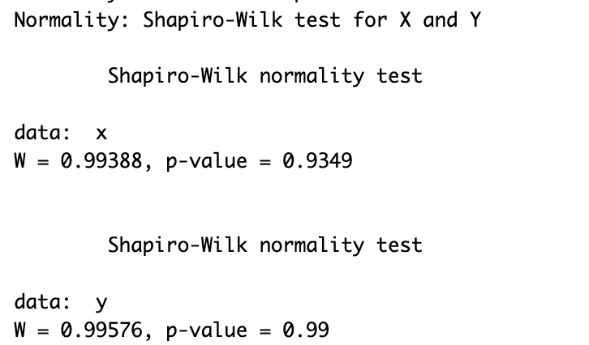
Correlation
Saint-Petersburg 2025
Normality of data can be assessed via Shapiro-Wilk test:
H0: The data is normally distributed (p-value > 0.1)
H1: The data is not normally distributed (p-value < 0.1)

Slide 9
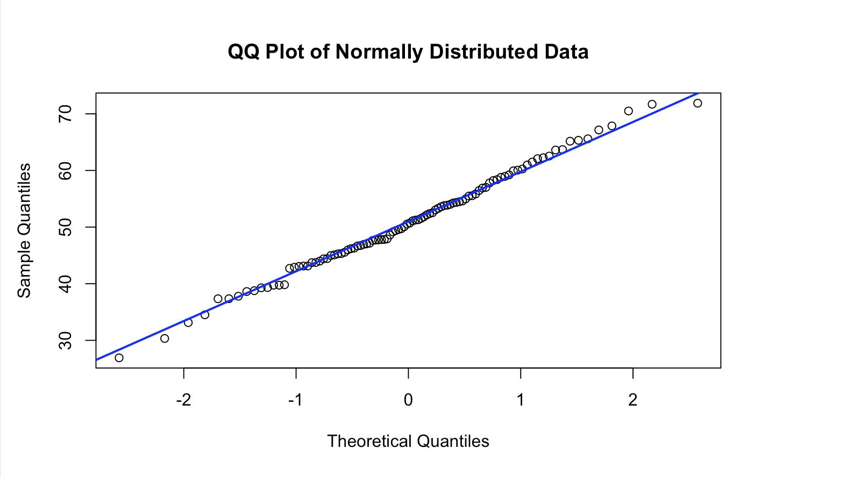
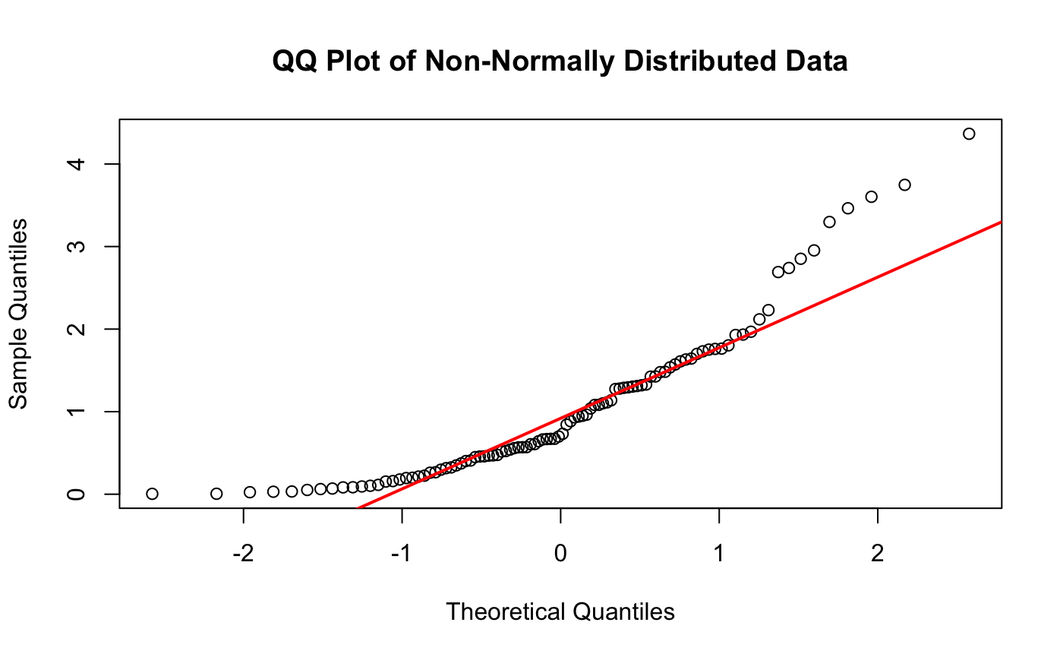
Correlation
Saint-Petersburg 2025
Or you can build a QQ-plot
It compares theoretical quantiles of a normal distribution with sample quantiles

Slide 10
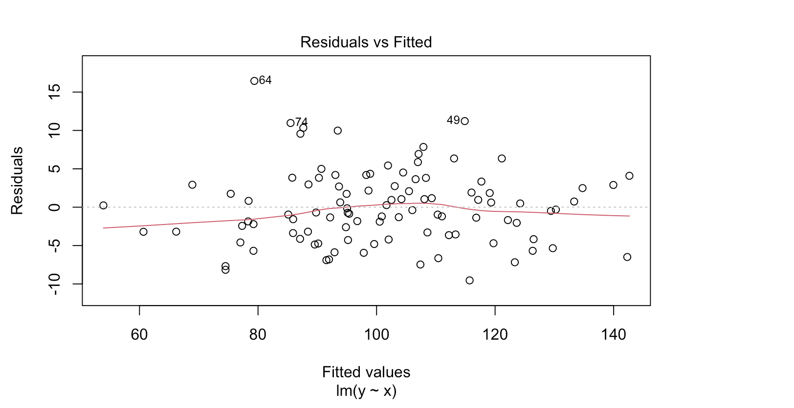

Correlation
Saint-Petersburg 2025
Homoscedasticity can be checked by plotting residuals of the model and estimated (fitted) values of the model.
This data should not follow a pattern and be consistently distributed

Slide 11
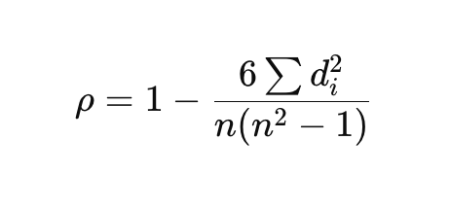

Correlation
Saint-Petersburg 2025
If these assumptions are not met, we should stick to non-parametric correlation coefficient - Spearman correlation coefficient
where:
Difference between ranks of x and y for each observation

Slide 12
Correlation
Saint-Petersburg 2025
Key characteristics of Spearman’s correlation coefficient:
Measures the monotonic relationship between variables (linear or non-linear)
Based on ranked data, so it is robust to outliers and does not require normality
Suitable for ordinal, continuous, or skewed data

Slide 13
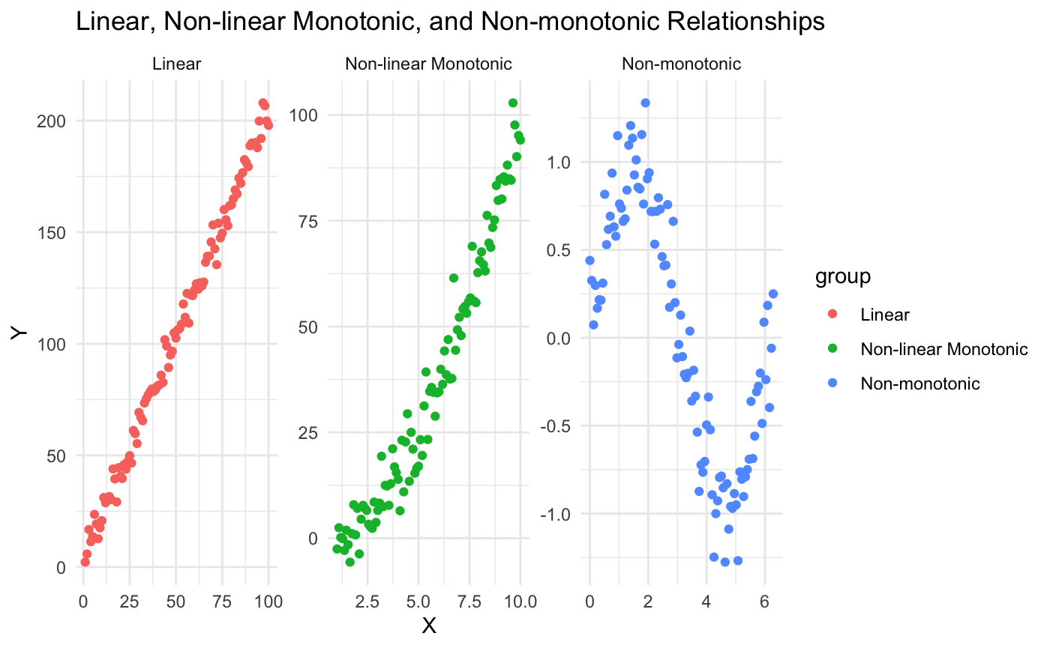
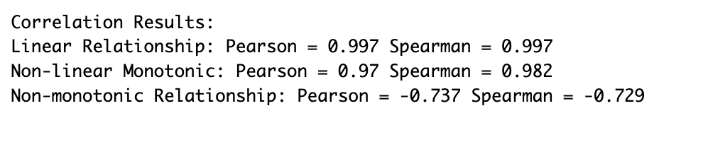
Correlation
Saint-Petersburg 2025

Slide 14
Statistical tests
Saint-Petersburg 2025
T-test (paired and independent), chi-sq test and other non-parametric tests

Slide 15
Statistical tests
Types of statistical tests:
Parametric tests (requires data to follow a list of assumptions)
Non-parametric tests (has no requirements to data)

Slide 16
Statistical tests
Parametric tests:
t-test
ANOVA
Linear regression
Pearson correlation coefficient

Slide 17
Statistical tests
Assumptions that parametric tests require are:
Linearity
Normality
Homogeneity of variances
No outliers in data
We talked about them when we described Pearson correlation coefficient

Slide 18
Statistical tests
T-test: paired and independent
T-test is a statistical test used to compare means of two groups to tell if they are significantly different from each other. There are 3 types of t-tests
Paired t-test
Independent t-test
One sample t-test
Compares the difference between two dependent groups
Example: we want to compare anxiety level before the mobilization and after. The group is the same but we did something with it and measure the results after this treatment
Compares the difference between two independent groups
Example: we want to compare mean income between males and females
Compares the difference between a single group with a know or hypothesized population mean
Example: we want to compare life satisfaction index of Saint-Petersburg residents to the national average

Slide 19
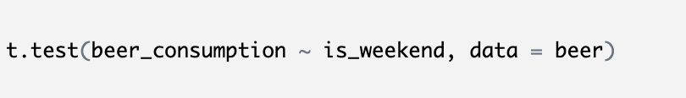
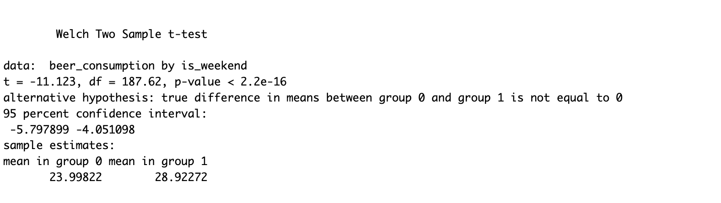
Statistical tests
Example of independent t-test

Slide 20
Statistical tests
Example of an independent t-test

Slide 21
Statistical tests
The Chi-Square Test is a non-parametric statistical test used to examine relationships between categorical variables. It evaluates whether observed frequencies in a contingency table differ significantly from the expected frequencies under the assumption of independence.
H0: one categorical variables is independent of another one
H1: One categorical variable is dependent on another one

Slide 22
Statistical tests
Chi-Square Test
Chi-squared test of independence — tests whether there's a relationship between two categorical variables.
Example: does brand preference depend on gender?
Solution: You build a contingency table and
compare observed frequencies with expected frequencies under the assumption of independence.
Chi-squared goodness-of-fit test — tests whether the distribution of a single variable matches an expected/theoretical distribution.
Example: are sales evenly distributed across days of the week?
χ² = Σ (O − E)² / E
where O = observed, E = expected.

Slide 23
ANOVA
Saint-Petersburg 2025
How ANOVA is different from t-tests and what kind of analysis can be done

Slide 24
ANOVA
Saint-Petersburg 2025
ANOVA is a statistical method used to compare the means of three or more groups
It is parametric, so requires the same assumptions about linearity, normality and homogeneity of variances as before
Unlike t-test, it requires an independent variable to have 3 or more levels to test the difference between them
Imagine, you have 3 marital statuses and want to see happiness score across 3 of them (married, widow, single)

Slide 25
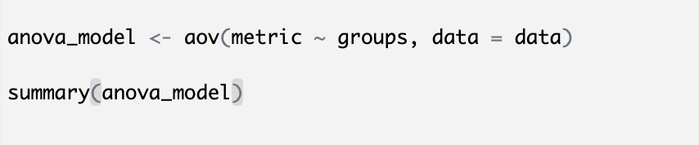
ANOVA
Saint-Petersburg 2025
This is how ANOVA is defined in R

Slide 26
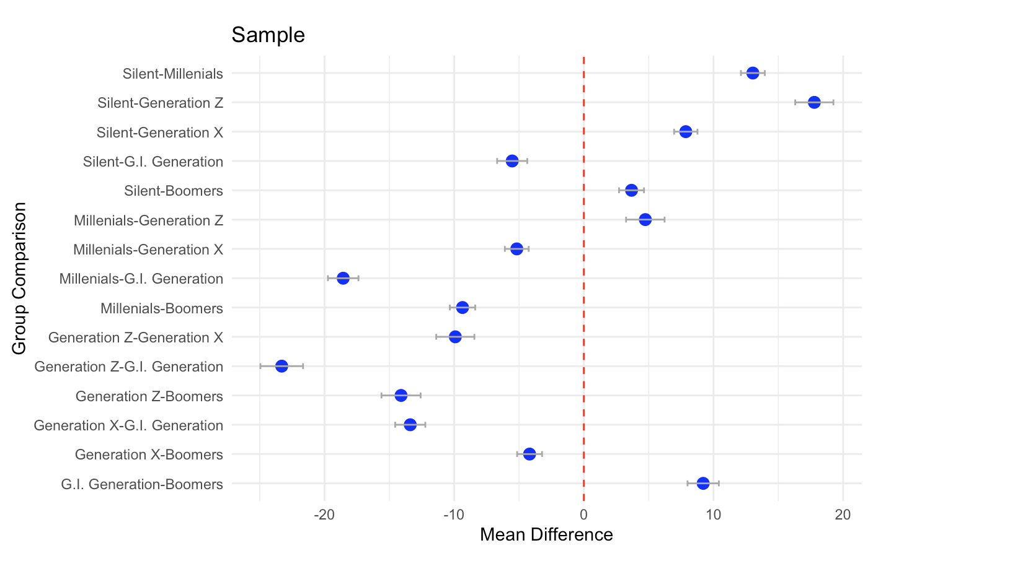
ANOVA
Saint-Petersburg 2025
For instance, this is a pairwise comparison of some metric about which we will talk later for different generations

Slide 27

ANOVA
Saint-Petersburg 2025
Two-Way ANOVA is used to examine the effect of two independent categorical variables (factors) on a continuous dependent variable, as well as their interaction effect.
We we talk about main and interaction effects in more detail in the practice part

Slide 28

Saint-Petersburg 2025
Thank you for attention!

